Slide 1


CAPSTONE PROJECT
E-commerce Sales Analysis
Presented By
Student Name: K. Sai hima sindhu
College Name: international school of technology and sciences for women
Department: Computer Science and engineering
Email ID:sindhukancherla2003@gmail.com

Slide 2
OUTLINE:
Problem Statement (Should not include solution)
Proposed System/Solution
System Development Approach (Technology Used)
Algorithm & Deployment
Result (Output Image)
Conclusion
Future Scope
References

Slide 3
Problem Statement:
E-commerce companies generate large volumes of sales data from customers, products, and transactions. However, analyzing this data manually makes it difficult to identify trends, customer behavior, and product performance. Businesses require an interactive dashboard to monitor key performance indicators such as total sales, profit, product category performance, and regional sales distribution.
Therefore, there is a need for a data visualization system that can analyze and present sales data effectively to support business decision-making.

Slide 4
Proposed Solution:
The proposed system aims to analyze e-commerce sales data and provide meaningful insights through an interactive dashboard. This system uses data visualization and analytics techniques to help businesses monitor sales performance, identify trends, and support better decision-making.
Data Collection:
Gather historical sales data from the e-commerce platform, including order details, customer information, product categories, payment modes, and location data.
This data serves as the foundation for analyzing sales performance and customer behavior.
Data Preprocessing:
Clean and preprocess the collected data to handle missing values, remove duplicates, and ensure data consistency.
Organize the data into structured tables and establish relationships between datasets such as Orders and Sales Details.
Data Modeling
Create relationships between tables and build calculated measures using DAX (Data Analysis Expressions) such as total sales, total profit, and profit margin.
This step enables efficient data analysis and supports advanced visualizations.
Dashboard Development
Develop an interactive dashboard using Microsoft Power BI that includes various visualizations such as sales trends, category performance, regional sales distribution, and customer analysis.
Deployment
Publish the dashboard to a secure platform where users can access and interact with the visualizations in real time.
This enables business stakeholders to monitor performance and make data-driven decisions effectively.

Slide 5
System Approach:
The system follows a data analysis and visualization approach:
Data Collection Sales data containing order details, customer information, product categories, and payment modes.
Data Cleaning Handling missing values and organizing the dataset.
Data Modeling Creating relationships between tables such as Orders and Details.
Dashboard Development Creating interactive visualizations using Power BI.

Slide 6
Tools & Technologies Used:
Microsoft Power BI
Data Visualization
Data Modeling
DAX (Data Analysis Expressions)
Excel / CSV datasets
.

Slide 7
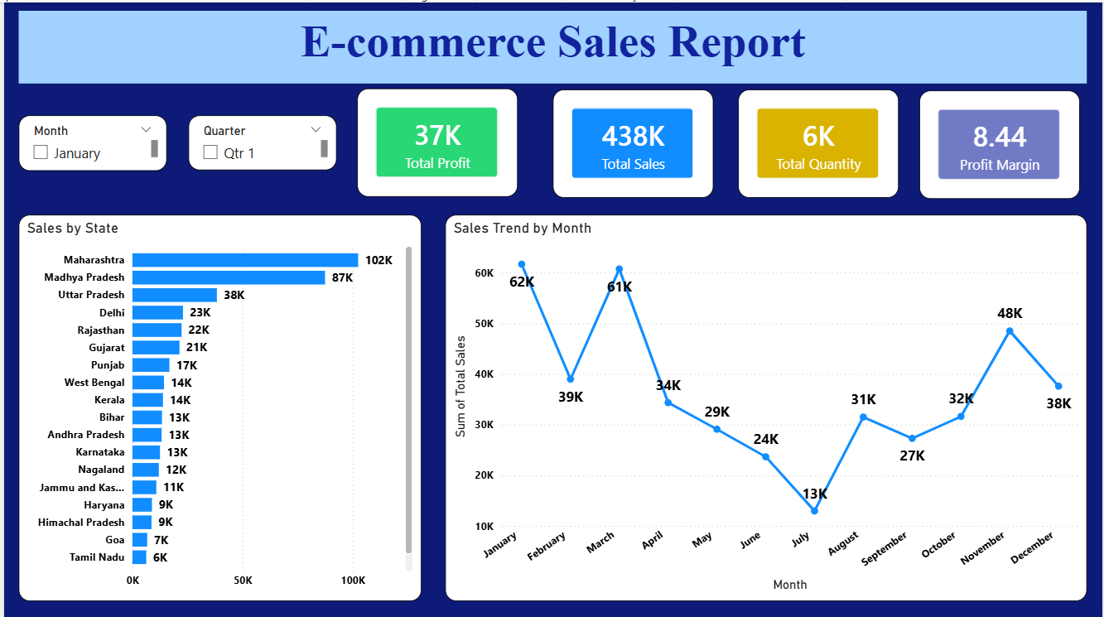
Result:

Slide 8
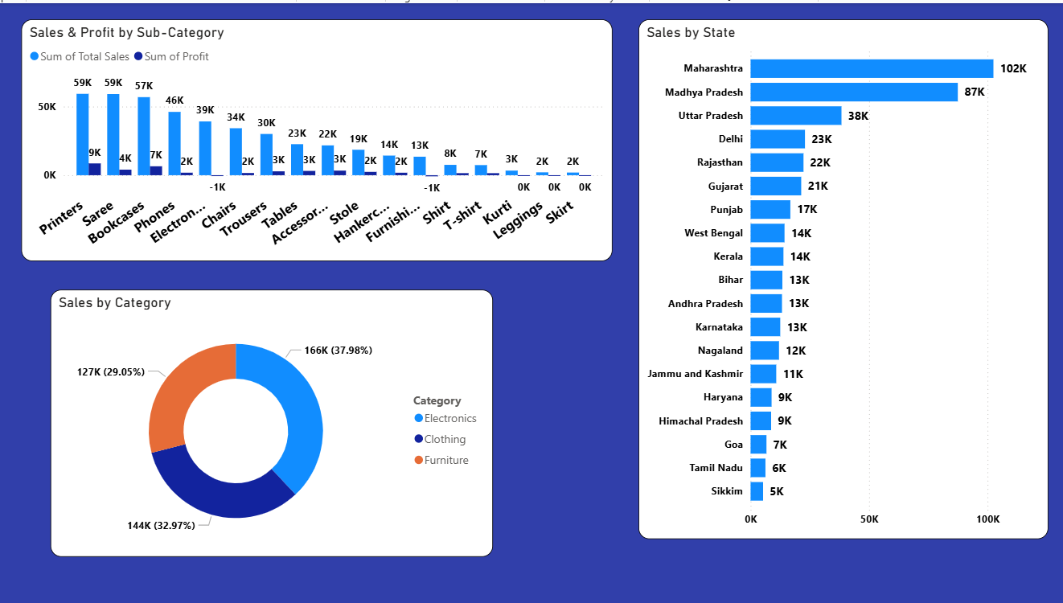

Slide 9
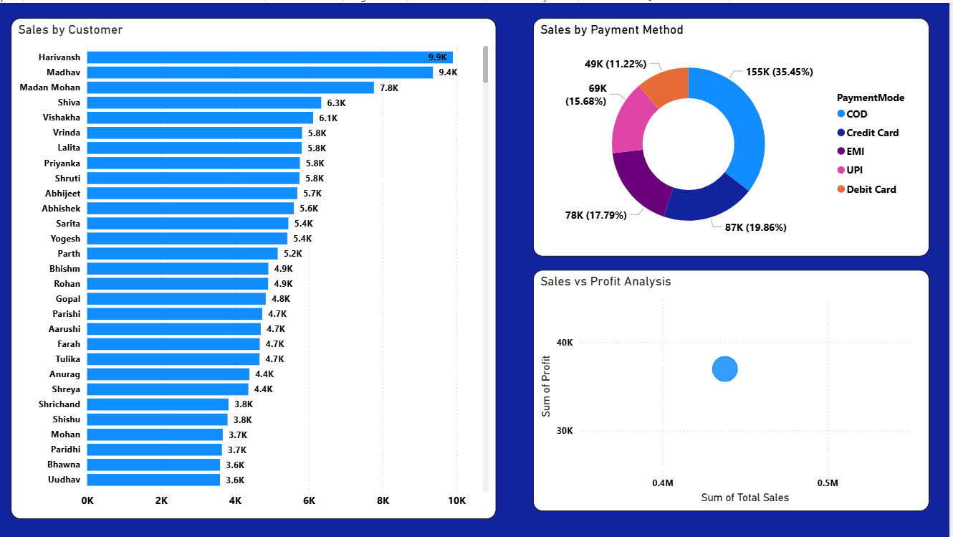

Slide 10
Conclusion:
The E-commerce Sales Analysis Dashboard provides a comprehensive overview of sales performance using interactive visualizations. It allows businesses to analyze sales trends, customer behavior, and product performance efficiently. The dashboard simplifies data interpretation and supports better decision-making.

Slide 11
Future scope:
Integration with real-time sales data
Advanced predictive analytics for demand forecasting
Implementation of machine learning models for sales prediction
Deployment of the dashboard on cloud platforms

Slide 12
References:
List and cite relevant sources, documentation, and articles that were helpful in developing the proposed solution. These may include Power BI documentation, data visualization techniques, and resources related to e-commerce sales data analysis. The references help ensure that the dashboard design and data analysis follow industry best practices.
GitHub Link: Link

Slide 13
Thank You

